Slide 1
AdvisHER – Advise HER
Team: AI – The Beginning

Slide 2
Team Info:
Sai Koushik Parachi: Working in American Bureau of Shipping project, GE,ACIS as a Developer.
Priyanka Jain: FS-ADM Pre Sales as a Consultant.
Ganesh Babu Karna: Working in CARM/RISK-IT project, FS-ADM-HSBC as a BA.
Shiva Rama Krishna: Working in CARM/RISK-IT project, FS-ADM-HSBC as a Developer.
Atul Gupta: Belongs to I&D Practice and working in technical lead role.
Dipanjan Biswa: Belongs to I&D Practice and working as a Developer.

Slide 3

Problem and Data:
Looking at the increase in the Women Health Care Requirements at a rapid pace of 6% y-o-y, we realize that understanding these patterns could greatly influence and help in delivering expert advice and quality care. This analysis is based on survey data conducted by a US non-profit organization for 3 consecutive years.
A US non profit organization has provided survey related information for 3 consecutive years of various women along with 14 possible health care requirements that they needed in the last one year.
People across the United States were asked a series of over 1700 questions about their demographics, pregnancies, family planning, use of healthcare services, and medical insurance. We're focusing only on women respondents for this project.
There are 9 categories of question with a few groups combined as follows:
Category A – Demographics, Household & Childhood
Category B – Pregnancy, Birth & Adoption
Category C – Martial & Relationship History
Category D – Sterilizing Operations and Impaired Fecundity
Category E – Contraceptive History & Pregnancy Wantedness
Category F – Family Planning & Medical Services
Category G – Birth Desires & Intentions
Category H – Infertility Services & Reproductive Health
Category I – Insurance, Residence, Religion, Work History, Child Care, Attitudes
This solutions aims at predicting the possible women health care requirements in the future out of the 14 requirements identified.

Slide 4
SOLUTION to solve this Problem.
As it’s a multi-label classification problem we followed the below key approach
Random Forest for identifying feature importance’s.
To start with we build base ‘logistic regression’ model.
To solve the problem of multi-label data set (multi-class classification) we build ‘OneVsRest Classifier’(OVR) model.
On top of OVR we built classifier chain model to identify performance using Ensamble way.
Dataset used to solve this challenge, which contains 14645 data points each with 1242 features and 14 possible labels. Each Data point has at least one label. As a baseline we first train a Logistic Regression classifier for each of the 14 labels. To evaluate the performance of these classifiers we predict on a held-out test set and calculate the Jaccard similarity score.

Slide 5
One-vs-the-rest (OvR) multiclass/multi-label strategy:
OvR also known as one-vs-all, this strategy consists in fitting one classifier per class. For each classifier, the class is fitted against all the other classes. In addition to its computational efficiency (only n_classes classifiers are needed), one advantage of this approach is its interpretability. Since each class is represented by one and one classifier only, it is possible to gain knowledge about the class by inspecting its corresponding classifier. This is the most commonly used strategy for multiclass classification and is a fair default choice. This strategy can also be used for multi-label learning, where a classifier is used to predict multiple labels for instance, by fitting on a 2-d matrix in which cell [i, j] is 1 if sample i has label j and 0 otherwise. In the multi-label learning literature, OvR is also known as the binary relevance method.
Classifier Chain strategy:
After OvR we create 10 classifier chains, each classifier chain contains a logistic regression model for each of the 14 labels. The models in each chain are ordered randomly. In addition to the 103 features in the dataset, each model gets the predictions of the preceding models in the chain as features (note that by default at training time each model gets the true labels as features).
These additional features allow each chain to exploit correlations among the classes. The Jaccard similarity score for each chain tends to be greater than that of the set independent logistic models. Because the models in each chain are arranged randomly there is significant variation in performance among the chains. Presumably there is an optimal ordering of the classes in a chain that will yield the best performance.
However we do not know that ordering a priori. Instead we can construct an voting ensemble of classifier chains by averaging the binary predictions of the chains and apply a threshold of 0.5. The Jaccard similarity score of the ensemble is greater than that of the independent models and tends to exceed the score of each chain in the ensemble (although this is not guaranteed with randomly ordered chains).

Slide 6
TECHNOLOGY used to develop solution:
Programming Language used in solving challenge:
Python -3.6
Algorithms Used in solving challenge:
Random Forest.
Logistic Regression.
OVR classifier.
Classifier Chain.
Libraries/Tools used in solving challenge:
Pandas.
Numpy.
Matplotlib.
Sci-Kit Learn.
Source code & Data sets:
https://github.com/sparachi1011/Hackathon_CG
https://youtu.be/t-289j4-6K8

Slide 7
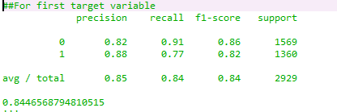
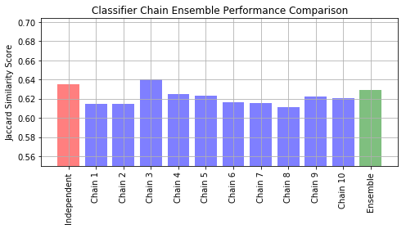
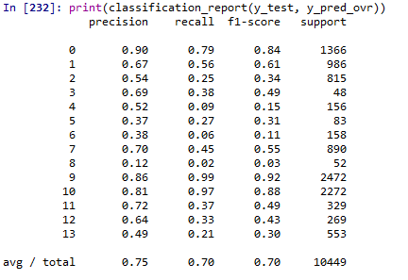
ROBUSTNESS: Results of metric’s for certifying model performance.
Classification report of base logistic regression for first target variable:
Final Output:
Classification report of first OVR Classifier output:

Slide 8
Thank You.

